Slide 1



Moogle

Slide 2
Today..
ER SQL
Technology used
Action plan

Slide 3
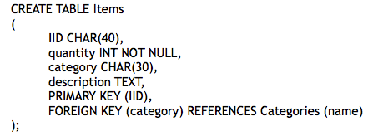
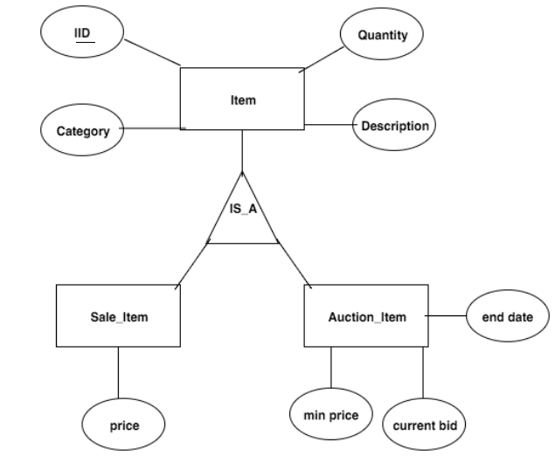
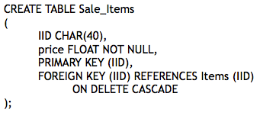
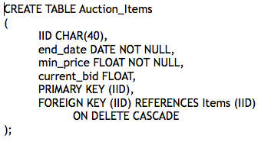
ER to SQL: Items

Slide 4
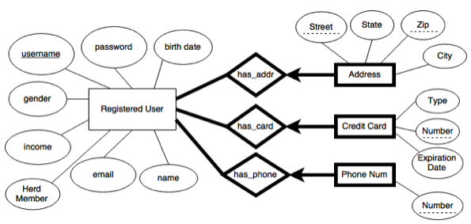
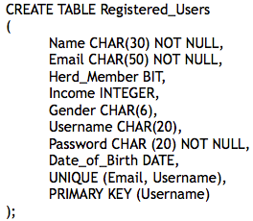
ER to SQL: Users

Slide 5
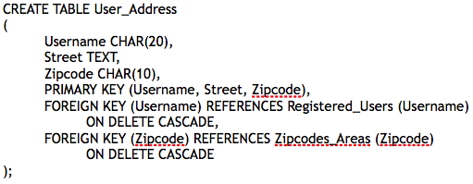
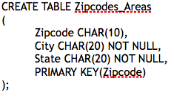
ER to SQL: Users (cont.)

Slide 6
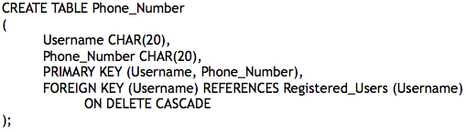
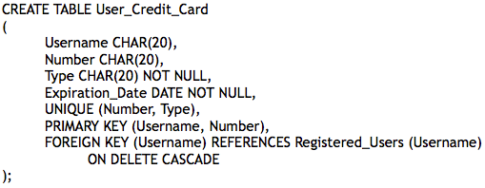
ER to SQL: Users (cont.)

Slide 7
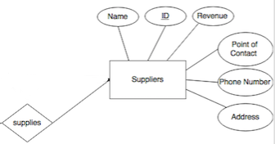
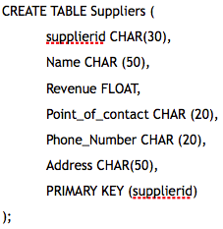
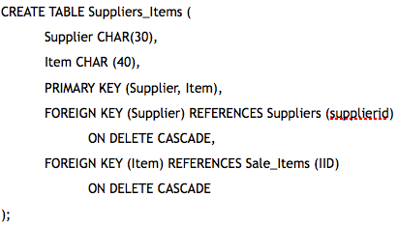
ER to SQL: Suppliers

Slide 8
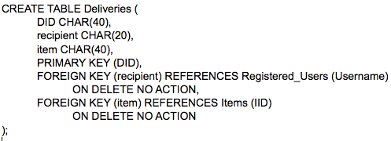
ER to SQL: Deliveries

Slide 9

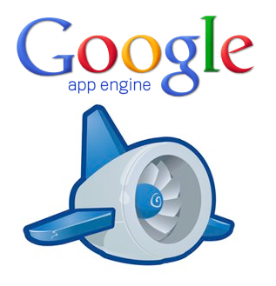
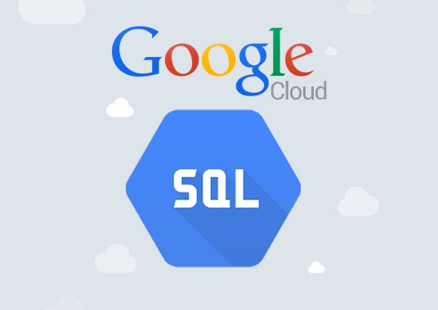
Technology

Slide 10
Google App Engine
“a platform as a service (PaaS) cloud computing platform for developing and hosting web applications in Google-managed data centers”
Google: “You worry about how you want your web app to look (HTML/CSS) and handle data (Python) and we’ll worry about server issues and scaling”
Benefits…

Slide 11
It’s Free
Google App Engine is free to use up to a certain level of consumed resources
Good for a project that probably won’t live past May..
If your app starts to draw A LOT of requests or consumes a lot of resources, you’ll be charged for additional storage/bandwidth
Not a major concern for this project

Slide 12
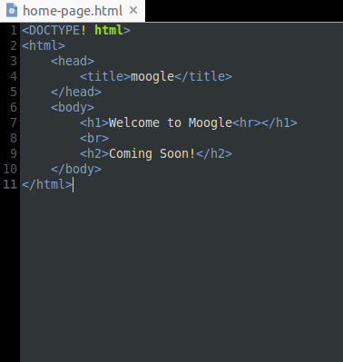
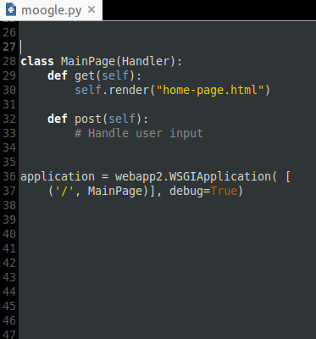
Easy to Use

Slide 13
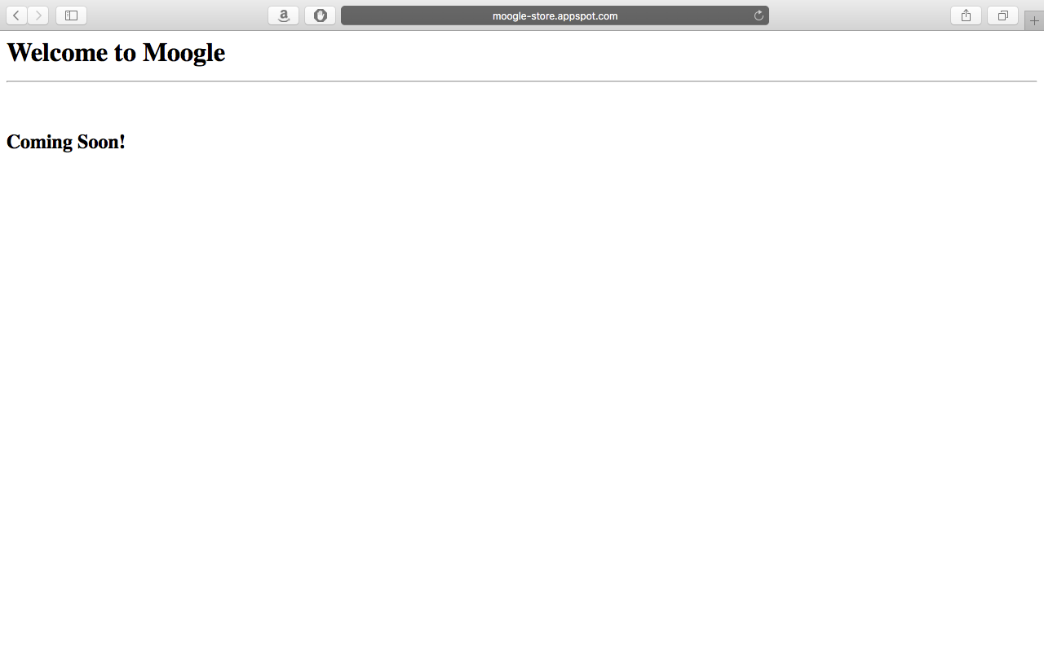

Slide 14
Provides MySQL Support
Google Cloud SQL
Allows you to create DB instance that your App Engine app can access
Can connect, post, and get from your database within your Python code
Google Cloud Datastore
Uses SQL-like language, GQL
Easier to use within the Google App Engine environment
Very similar to SQL, but some differences/restrictions (no “Join”s)

Slide 15
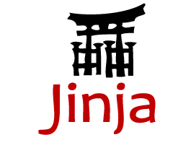
Jinja2
Template engine for the Python programming language
Brings Python-like syntax to HTML (for loops, if statements, etc.)
Automatic HTML escaping
Template inheritance
Easy to debug

Slide 16
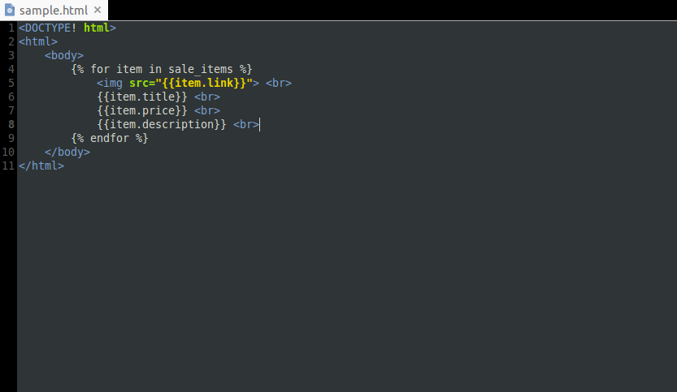
Using Jinja2

Slide 17
Learn more
Free course at Udacity
https://appengine.google.com
http://jinja.pocoo.org/docs/dev/
Visit Moogle now at : moogle-store.appspot.com

Slide 18
Action Plan
Populate database using Scrapy or BeautifulSoup
Build the website!

